Slide 1




[Chapter Name]
[University]
[Presenter Name / Role]
[Date]
Notes:
Introduce advocacy as a meaningful part of student leadership and future professional identity in CSD.

Slide 2




Advocacy is taking action to support a cause or position.
In communication sciences and disorders, advocacy means working to ensure that people with speech, language, hearing, and swallowing disorders have access to:
they need to communicate effectively and participate fully in their communities.
Services
Support
Resources
Notes:
Source: https://www.nsslha.org/programs/advocacy/what-is-advocacy/

Slide 3
(A)dvocacy | (a)dvocacy
Speaking with policymakers or decision-makers | Supporting advocacy efforts behind the scenes
Formal policy or professional advocacy | Participating in events, campaigns, or initiatives
Leading campaigns or organizational efforts | Taking small actions that contribute to change
Change happens because both are happening at the same time.
Notes:
Source: https://www.nsslha.org/programs/advocacy/what-is-advocacy/

Slide 4
If we truly believe that every voice matters, then we must believe that our own matters, too.
Decisions at the local, state, and federal levels can affect services, technology, coverage, and care
Students bring valuable perspective to conversations that affect their future profession
Promotes awareness, equity, inclusion, and access
Helps build a better future for clients, the professions, and you.
Notes:
Connect this to future practice: advocating for services, navigating access to care or hearing technology, and supporting clients and families.
Source: https://www.nsslha.org/programs/advocacy/why-advocacy-matters/

Slide 5

You may not think of yourself as an advocate yet—but chances are, you already are.
Think of a time that you’ve helped someone be heard, asked a needed question, or supported an inclusive environment
Notes:
Ask members to reflect briefly on a time they helped someone be heard, asked a needed question, or supported an inclusive environment.

Slide 6

1
Only certain people have the skills needed to do state or federal advocacy.
2
Advocacy yields fast results.
3
Organizing an advocacy event is complicated.
Notes:
A lot of people have some misconceptions about advocacy—here are the top 3!
The number three myth: Organizing an advocacy event is complicated. False! National NSSLHA so many tools and opportunities for your chapter to participate in advocacy events, either on our Student Advocacy Days or other times throughout the year. It can be as simple as getting together over pizza, pulling out your laptops, and filling in some info on the Take Action site, or of course, if you want to, you can do something in person at your state capital. What’s important to remember is that it doesn’t have to be complicated. It can be very simple!
The number two myth: Advocacy yields fast results. Advocacy is a process. Although we all love the instant gratification of seeing fast change, the reality is that the legislative process takes time. It’s important to make our voices heard at all stages of the process in order to be effective. Changing laws is a slow roll, so we have to be able to be okay with small victories, knowing that together they lead to big change.
And finally, the number one myth: Only certain people have the skills needed to do federal advocacy. Completely false! Advocacy is for everyone—with the tools and methods we have available, it is something that every member of your chapter can participate in!

Slide 7




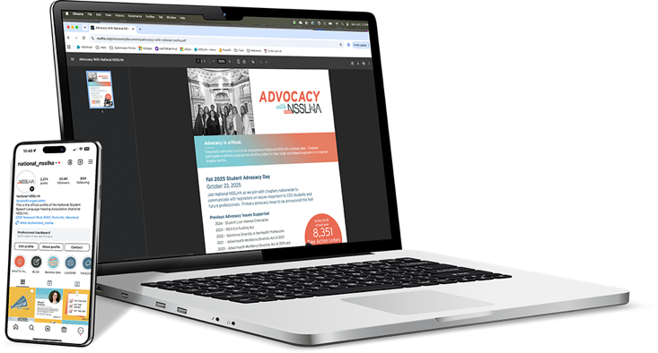
Host a Take Action letter-writing session.
Plan a virtual advocacy hour.
Add a brief advocacy update to chapter meetings.
Use NSSLHA’s Advocacy Toolkit and Chapter Idea Bank for activity ideas.
Notes:
A lot of members think we have to plan a huge gala or go to D.C. to 'do advocacy,' but NSSLHA’s research and experience show that some of the most effective chapter work is actually the most simple.
The Advocacy Idea Bank and Toolkit on the NSSLHA website are filled with ready-to-use activities.
Advocacy is a habit, not just a one-time event

Slide 8
Event: [Advocacy Day Name]
Date: [Month Day, Year]
Location/Format: [In person / Virtual / Hybrid]
Chapter contact: [Name / Email]
Notes:
For those interested in helping to advocate, we’ve added our chapter's next upcoming advocacy action here on the slide: [Leader: Mention the specific chapter activity and date here].
This is our chance to practice these skills as a group before we graduate.

