Slide 1
Member Benefits
No portion of this presentation may be copied or distributed without expressed written consent of National NSSLHA.
Notes:
National NSSLHA offers students access to academic resources, significant discounts, scholarships, and leadership and advocacy opportunities.

Slide 2
BENEFITS OF NATIONAL NSSLHA MEMBERSHIP
ACADEMIC RESOURCES
MONEY SAVING DISCOUNTS
OPPORTUNITIES
ASHA’s 4 scholarly journals
The ASHA Leader (print edition)
NSSLHA and ASHA staff for any subject—the professions, clinical fellowships, ethics, and more
NSSLHA to ASHA Conversion Discount (save $250)
Reduced Convention Registration (over 50% off)
SIG Discount (save $35)
Liability insurance
Discounts on movies, concert tickets, travel, food delivery, office supplies, and more
Discounts on products and publications through the ASHA Store
Scholarships
(undergrad and grad)
Member Honors
(cash awards)
Advocacy
Leadership
Networking
Notes:
Let’s talk about National NSSLHA membership benefits…
Take a moment to read through some of the many great benefits National NSSLHA offers.
In addition to having access to ASHA’s scholarly journals and a print version of the ASHA Leader, did you know, that as a National NSSLHA member you have access to talk to NSSLHA and ASHA staff about any topic! Have a question about your clinical fellowship? Just call ASHA’s Action Center and they’ll put you in touch with the right staff member to chat.
There are financial benefits to joining National NSSLHA, too! The NSSLHA to ASHA Conversion Discount is an awesome benefit for grad students, which I’ll tell you more about in a bit.
But did you know you can join one of ASHA’s Special Interest Groups for only $10 per year? That’s $35 in savings and gives you access to resources and certified professionals who are interested in the same CSD topics you are!

Slide 3


Clinical Resources
Access to Academic Journals:
American Journal of Audiology
American Journal of Speech-Language Pathology
Journal of Speech, Language, and Hearing Research
Language, Speech, and Hearing Services in Schools
Notes:
Having access to current research is importance for students, and, as a National NSSLHA member, you have access to ASHA’s four academic journals. Not only will these resources help you ace those papers, but the evidence-based information can support you in your clinical work.

Slide 4

Clinical Resources
Access to Practice Portal:
Is an easy-to-navigate tool
s a collection of essential resources for students and professionals
Covers both clinical topics and professional issues
Is constantly evolving as new topics are suggested
Notes:
Another essential tool you can use as a National NSSLHA member is ASHA’s Practice Portal. The ASHA Practice Portal is an easy-to-navigate tool that connects you to resources, evidence, and strategies—all in one place!
As a student, this tool will be helpful as you write research papers, design treatment plans for clients, plan advocacy projects, or simply figure out what interests you as a future clinician.
As a professional, this tool will help you when you’re faced with a client where your tried-and-trues just aren’t working.

Slide 5
SPECIAL INTEREST GROUPS (SIGs)
SIG 1: Language Learning and Education
SIG 2: Neurogenic Communication Disorders
SIG 3: Voice and Upper Airway Disorders
SIG 4: Fluency and Fluency Disorders
SIG 5: Craniofacial and Velopharyngeal Disorders
SIG 6: Hearing and Hearing Disorders: Research and Diagnosis
SIG 7: Aural Rehabilitation and Its Instrumentation
SIG 8: Audiology and Public Health
SIG 9: Hearing and Hearing Disorders
in Childhood
SIG 10: Issues in Higher Education
SIG 11: Administration and Supervision
SIG 14: Cultural and Linguistic Diversity
SIG 15: Gerontology
SIG 16: School-Based Issues
SIG 17: Global Issues in Communication Sciences and Related Disorders
SIG 18: Telepractice
SIG 19: Speech Science
SIG 20: Counseling
NATIONAL NSSLHA MEMBERS CAN JOIN SIGS FOR JUST $10!
asha.org/sig
Notes:
There 20 SIGs that offer specialized communities for networking, resource sharing, and events. National NSSLHA members can join SIGs for just $10!

Slide 6


BIG SAVINGS
Notes:
In addition to the discounts on the ASHA Convention and Special Interest Groups, being a National NSSLHA member gives you another big discount.

Slide 7


NSSLHA TO ASHA CONVERSION DISCOUNT
SAVE
$250
Hold National NSSLHA membership the
last 2 years of your grad or doctoral program, including at graduation
Pay for your initial ASHA membership and certification by August 31 up to a year after your graduation date
Save $250 off initial dues and fees for ASHA membership and certification
Class of 2025 –
That means you need National NSSLHA membership in 2024 and 2025.
2024 National NSSLHA membership opened in September 2023.
Notes:
The NSSLHA to ASHA Conversion Discount, saves students over $250 when they apply for ASHA membership and certification when they were a member of National NSSLHA the last 2 years of their graduate or doctoral program.

Slide 8
WHEN TO JOIN NATIONAL NSSLHA
2023 | JAN | FEB | MAR | APR | MAY | JUN | JUL | AUG | SEP | OCT | NOV | DEC
 |  |  |  |  |  |  |  |  | 2023 Membership Expires 12/31 2024 Membership Open
2024 | JAN | FEB | MAR | APR | MAY | JUN | JUL | AUG | SEP | OCT | NOV | DEC
 | Available For Purchase → |  |  |  |  |  |  |  | 2024 Membership Expires 12/31 2025 Membership Open
2025 | JAN | FEB | MAR | APR | MAY | JUN | JUL | AUG | SEP | OCT | NOV | DEC
 | Available For Purchase → |  |  |  |  |  |  |  | 2025 Membership Expires 12/31 2026 Membership Open
Notes:
National NSSLHA’s membership year follows very closely to the start of the academic year. The 2024 membership year opens in September and that is the best time to join or renew because you get 16 months for membership for the price of 12.

Slide 9
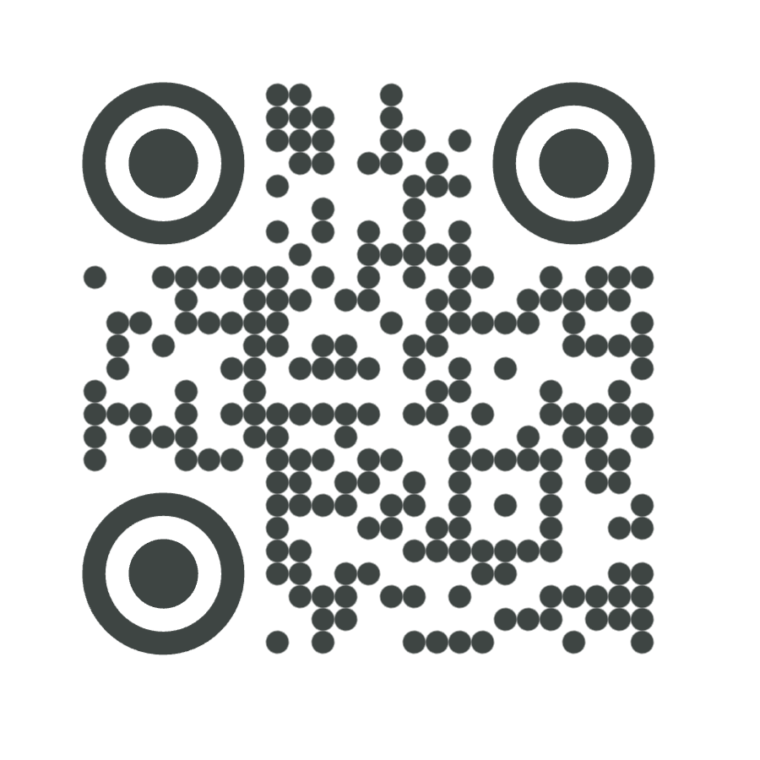
TO LEARN MORE, VISIT
nsslha.org/membership
Notes:
To learn more, visit National NSSLHA’s website using this address or QR code.

Slide 10

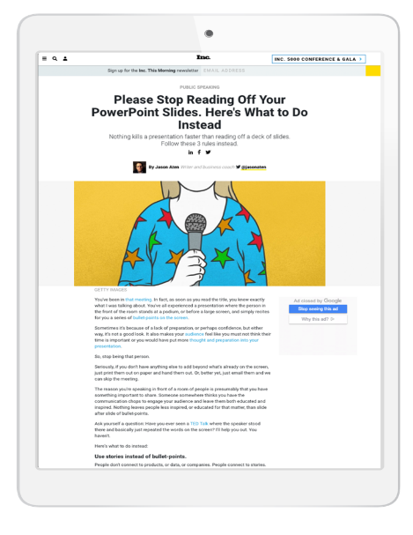
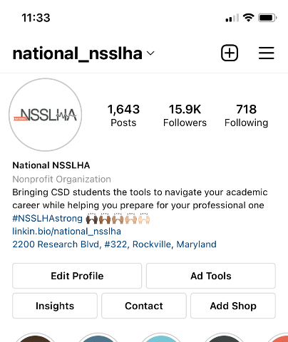
FOLLOW National NSSLHA
Social Media Channels
Instagram
LinkedIn
Facebook
TikTok
Twitter
National NSSLHA Blog
Instagram
Motivation Monday
NSSLHA Blog posts
What’s This Wednesday
Giveaways & more
Notes:
I’d like to encourage you to follow National NSSLHA on their social media platforms and check out the NSSLHA Blog.

