Slide 1
Scholarships
No portion of this presentation may be copied or distributed without expressed written consent of National NSSLHA.
Notes:
Let me tell you about National NSSLHA’s scholarship programs.

Slide 2


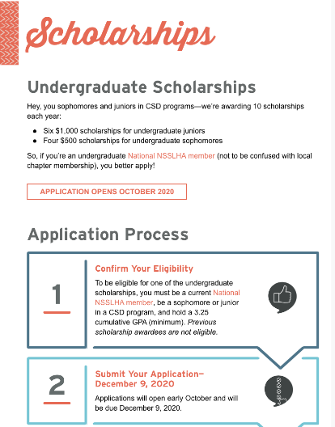
National NSSLHA Undergrad Scholarships
DUE DECEMBER 31
Revised Application Requirement
WHAT’S IN IT FOR STUDENTS?
Six $1,000 scholarships for
undergraduate juniors
Four $500 scholarships for
undergraduate sophomores
Applicants no longer have to obtain a letter of recommendation. We have developed a new reference form to make applying easier for students and their references.
Notes:
The National NSSLHA Undergrad Scholarship application opens in September, awarding 10 scholarships. It’s open to National NSSLHA members who are undergrad juniors or seniors. NSSLHA is excited to announce a change to the undergraduate scholarship program. They have removed the letter of recommendation requirement and will instead have a reference form with Likert Scale.
Visit nsslha.org/programs/scholarships to learn more or apply.

Slide 3


ASHFOUNDATION NSSLHA GRADUATE SCHOLARSHIPS
$5,000 National NSSLHA scholarships
Administered through the ASHFoundation
Funded by National NSSLHA and chapter donations through Chapter Honors
Eligibility: Undergraduate seniors entering master’s or AuD program, first-year
SLP students, and full-time AuD students
Notes:
National NSSLHA also offers $5,000 National NSSLHA Scholarships, administered through the ASHFoundation.
These scholarships are available for undergraduate seniors entering a master’s or AuD program, first-year SLP students, or full-time AuD students.
They’re funded by National NSSLHA and chapter donations through our Chapter Honors program.
For details about this scholarship, please visit ASHFoundation.org.

Slide 4

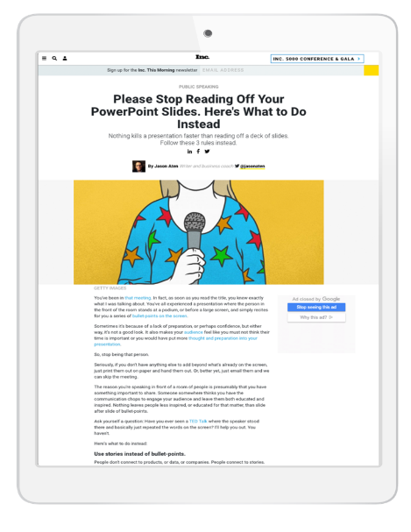
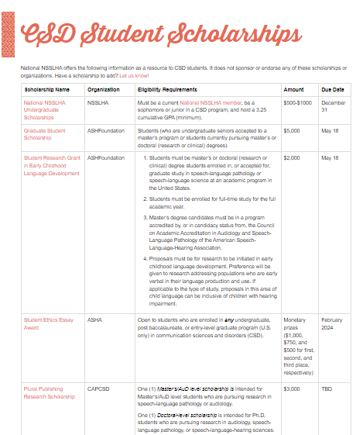
CSD STUDENT SCHOLARSHIPS
Other Scholarship Opportunities
National NSSLHA’s IDEA Work Group has created a new CSD Student Scholarships resource that lists scholarships available to students from various organizations.
Notes:
If you are looking for additional funding, visit the new CSD Student Scholarship resource developed by National NSSLHA’s IDEA Work Group. It offers eligibility, due date, and scholarship amounts from various organizations.

Slide 5
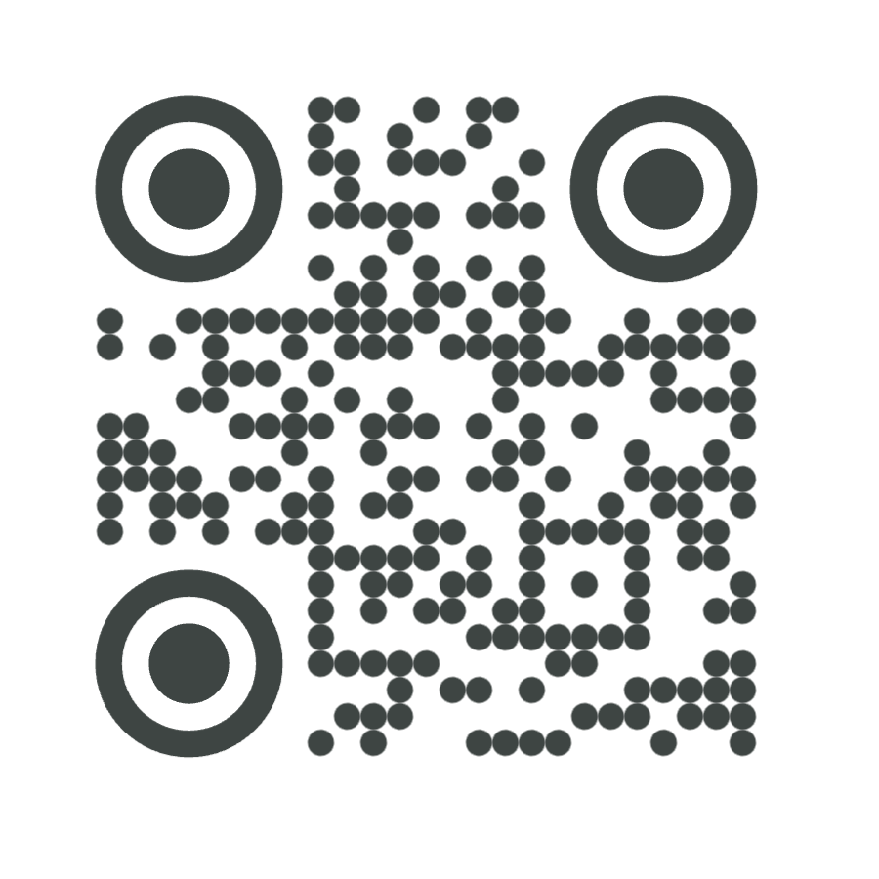
TO LEARN MORE, VISIT
nsslha.org/programs/scholarships
Notes:
To learn more, visit National NSSLHA’s website using this address or QR code.

Slide 6
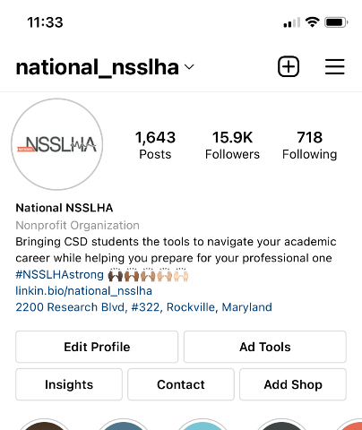
FOLLOW National NSSLHA
Social Media Channels
Instagram
LinkedIn
Facebook
TikTok
Twitter
National NSSLHA Blog
Instagram
Motivation Monday
NSSLHA Blog posts
What’s This Wednesday
Giveaways & more
Notes:
I’d like to encourage you to follow National NSSLHA on their social media platforms and check out the NSSLHA Blog.

