Slide 1
NSSLHA to ASHA Conversion Discount
No portion of this presentation may be copied or distributed without expressed written consent of National NSSLHA.
Notes:
National NSSLHA offers students access to academic resources, significant discounts, scholarships, and leadership and advocacy opportunities.
In addition to the discounts on the ASHA Convention and Special Interest Groups, being a National NSSLHA member gives you another big discount.

Slide 2
NSSLHA TO ASHA CONVERSION DISCOUNT
SAVE
$250
Hold National NSSLHA membership the last 2 years of your grad or doctoral program, including at graduation
Pay for your initial ASHA membership and certification by August 31 up to a year after your graduation date
Save $250 off initial dues and fees for ASHA membership and certification
Notes:
The NSSLHA to ASHA Conversion Discount saves students over $250 when they apply for ASHA membership and certification when they were a member of National NSSLHA the last 2 years of their graduate or doctoral program.

Slide 3
SEE THE SAVINGS
Plus, a special BONUS
Eligible National NSSLHA members pay less than other applicants:
BONUS: National NSSLHA members can also take advantage of ASHA’s New Professional Membership Package -- giving you up to two years of ASHA membership for the price of one!
Notes:
Eligible National NSSLHA members pay less than $300 for their initial ASHA dues and fees. In addition, they can take advantage of ASHA’s New Professional Membership Package – with both discounts you would pay $240 for two years of membership. A HUGE savings as you start your career.

Slide 4
WHAT TO DO
CLASS of 2025
Get 2024 National NSSLHA membership
Renew your membership in 2025
Pay for your ASHA membership and certification by August 31, 2026
CLASS of 2024
Have 2023 National NSSLHA membership
Renew your membership in 2024
Pay for your ASHA membership and certification by August 31, 2025
Notes:
As long as you are a National NSSLHA member the last two years of your graduate or doctoral program, the discount will be automatically added to your application.

Slide 5
WHEN TO JOIN NATIONAL NSSLHA
2023 | JAN | FEB | MAR | APR | MAY | JUN | JUL | AUG | SEP | OCT | NOV | DEC
 |  |  |  |  |  |  |  |  | 2023 Membership Expires 12/31 2024 Membership Open
2024 | JAN | FEB | MAR | APR | MAY | JUN | JUL | AUG | SEP | OCT | NOV | DEC
 | Available For Purchase → |  |  |  |  |  |  |  | 2024 Membership Expires 12/31 2025 Membership Open
2025 | JAN | FEB | MAR | APR | MAY | JUN | JUL | AUG | SEP | OCT | NOV | DEC
 | Available For Purchase → |  |  |  |  |  |  |  | 2025 Membership Expires 12/31 2026 Membership Open
Notes:
National NSSLHA’s membership year follows very closely to the start of the academic year. The 2024 membership year opens in September and that is the best time to join or renew.

Slide 6
TO LEARN MORE, VISIT
nsslha.org/membership/conversion-discount
Notes:
To learn more, visit National NSSLHA’s website using this address or QR code.

Slide 7
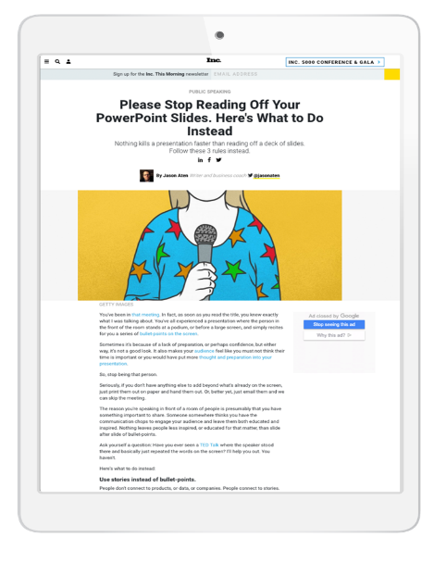
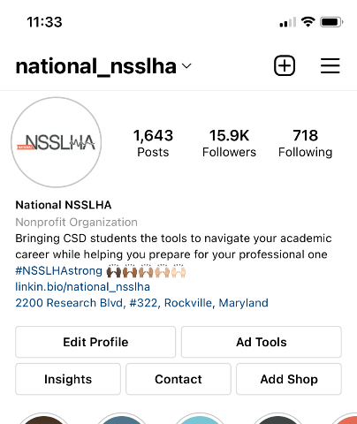
FOLLOW National NSSLHA
Social Media Channels
Instagram
LinkedIn
Facebook
TikTok
Twitter
National NSSLHA Blog
Instagram
Motivation Monday
NSSLHA Blog posts
What’s This Wednesday
Giveaways & more
Notes:
I’d like to encourage you to follow National NSSLHA on their social media platforms and check out the NSSLHA Blog.

